Slide 1
PROGRAMMABLE INTERVAL TIMER 8253/8254
Contents:
Why 8254/8253?
8254 Vs 8253.
Features and Application of 8253/8254.
Pin functions.
Read and Write Operation.
Modes of operation.
Problems on 8086-8254/8253 based system

Slide 2
What is 8254/8253?
The Intel 8254/8253 is a programmable counter/timer device designed to solve the common timing control problems in microprocessor system design.
8254 is the high speed version of the 8253.
When 8254/8253 used as timing and delay generation peripheral, microprocessor becomes free from tasks related to counting process and can execute program in memory, while timer device perform counting tasks.
Minimizes the software overhead on Microprocessor.
8254 Vs 8253
Characteristics | 8254 | 8253
Frequency Range | DC to 8 MHz DC to 10 MHz (8254-2) | DC to 2 MHz
Special Command | Status read-back command | No such command

Slide 3
Application
Real time clock
Event-counter
Digital one-shot
Programmable rate generator
Square wave generator
Binary rate multiplier
Complex waveform generator
Complex motor controller
8253/8254 Features
It includes three 16-bit counters that can work independently in 6 different modes.
It is packaged in a 24-pin DIP(Dual in-line package) and requires
+5V power supply.
It can count either in binary or BCD.
It’s counters can operate at a maximum frequency of 10 MHz for 8254 and 2MHZ for 8253.
8253 uses N-MOS technology and 8254 uses H-MOS technology.

Slide 4
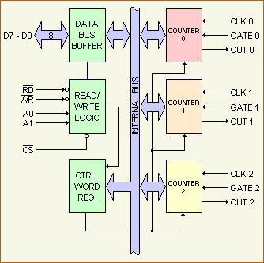
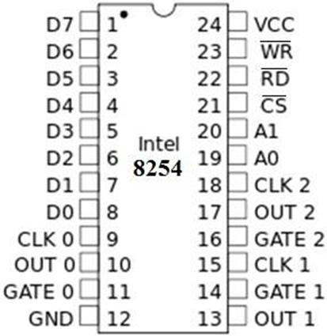
Architecture and PIN Diagram of 8253/8254

Slide 5
DATA BUFFER:
8-bit, bidirectional data buffer
Interfaces internal circuit of 8254/8253 to microprocessor system bus
Data transmitted or received by buffer upon execution of IN or OUT instruction.
Three basic functions
Programming the MODES of the 8253/8254.
Loading the count registers and
Reading the count values.
READ/WRITE LOGIC:
Controls the direction of data buffer depends on whether read or write operation.
IN instruction- read data and OUT instruction- writes data to peripheral

Slide 6
Counters 0, 1 and 2:
Three counters available in 8254/8253 are independent of each other in operation. Each counter has two input CLK and GATE and one output OUT.
All are 16 bit presettable down counters, able to operate either in BCD or Hexadecimal mode.
Speciality of this counter is that they can easily read on line without disturbing clock input.
This is called as “On the fly” reading of counters and it is invoked using mode control word.
Control Word Register:
Contain information that can be used for writing or reading the count value to or from respective count register using IN and OUT instructions.
This register selected when A0, A1 =1, and accept 8-bit control word written by Microprocessor and stores it for controlling the operation of specific counter.
It can be only written and cannot be read

Slide 7
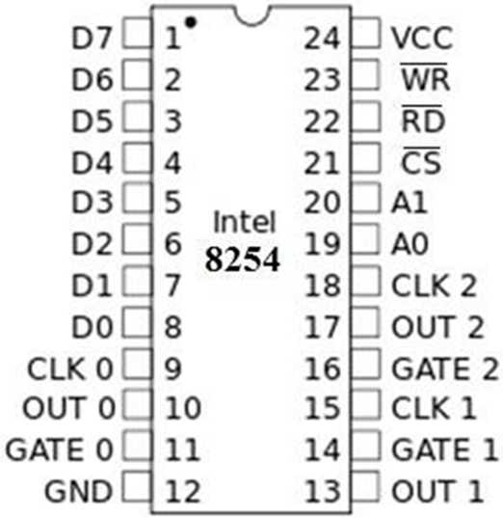
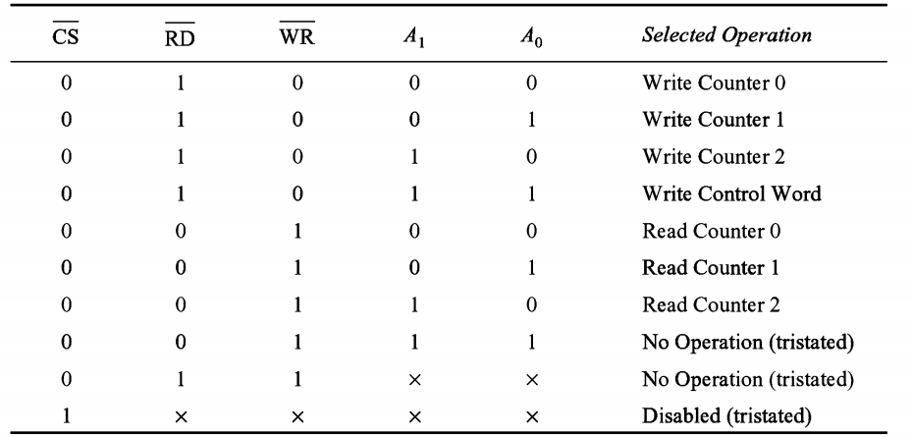
Pin functions
A0, A1: The address inputs select one of the four internal registers within the 8254.
A1 | A0 | Function
0 | 0 | Counter 0
0 | 1 | Counter 1
1 | 0 | Counter 2
1 | 1 | Control Word
CS : A low on Chip select enables the 8254 for programming and for reading or writing a counter.

Slide 8

Vcc: Power connects to the +5V power supply.
GND: Ground connects to the system ground bus.
GATE : The gate input controls the operation of the counter in some modes of operation.
GATE 0 | Gate input of counter 0
GATE 1 | Gate input of counter 1
GATE 2 | Gate input of counter 2

Slide 9

Pin functions (Continued)
D0-D7: Bidirectional three state data bus lines connected to system data bus.
CLK : The clock input is the timing source for each of the internal counters. This input is often connected to the PCLK signal from the microprocessor system bus controller.
CLK0 | Clock input of counter 0
CLK1 | Clock input of counter 1
CLK2 | Clock input of counter 2
OUT: A counter output is where the waveform generated by the counter is available.
OUT 0 | Output of counter 0
OUT 1 | Output of counter 1
OUT 2 | Output of counter 2
𝐑 𝐃 : Read causes data to be read from the 8254/8253 and often connected to the
IORC signal.
𝐖𝐑 : Write causes data to be written to the 8254/8253 and often connects to the
write strobe (IOWC)

Slide 10
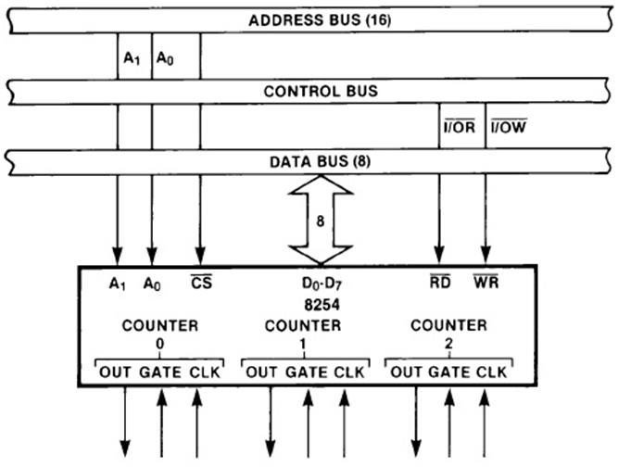
8254/8253 System Interface

Slide 11
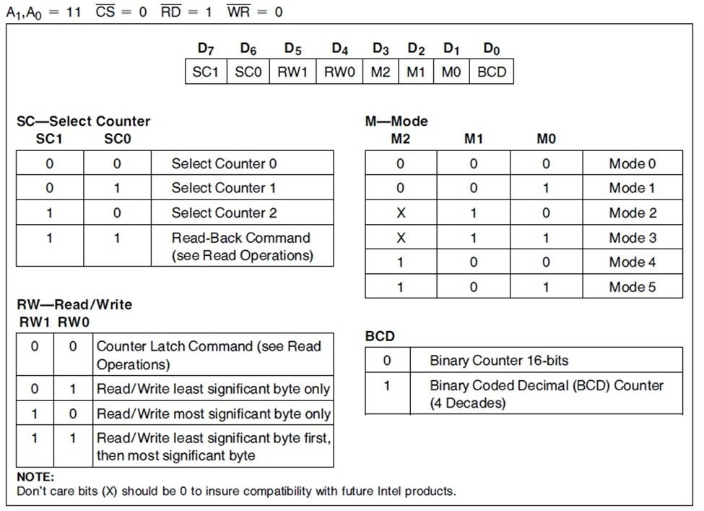
Programming the 8254 /8253 (Control Word Format)

Slide 12
8254/8253 Write operation
The programming procedure for the 8254 is very flexible. Only two conversion
need to be remember.
For each Counter, the Control Word must be written before the initial
count is written.
The initial count must follow the count format specified in the Control Word (least significant byte only, most significant byte only, or least significant byte and then most significant byte).
With a clock and an appropriate gate signal to one of the counters, the above steps should start the counter and provide appropriate output according to the control word.

Slide 13
Modes of Operation
Mode 0: Interrupt on terminal count.
Mode 1: Hardware Retriggerable One-Shot.
Mode 2: Rate Generator.
Mode 3: Square Wave Mode.
Mode 4: Software Triggered Mode.
Mode 5: Hardware Triggered Mode.

Slide 14
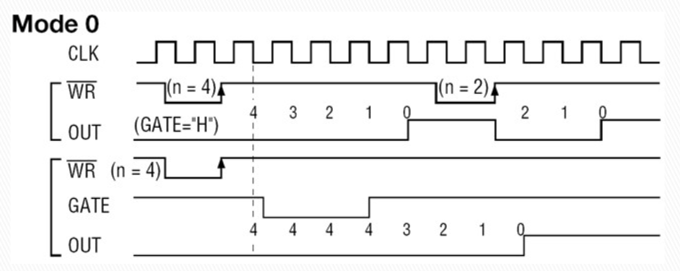
Mode 0: Interrupt on terminal count.
Mode 0 used for generation of accurate time delay under software control.
After the Control Word is written, OUT is initially low, and will remain low until the Counter reaches zero. OUT then goes high and remains high until a new count or a new Mode 0 Control Word is written into the Counter.
High output used to interrupt the processor, by setting terminal count

Slide 15

Mode 0: Interrupt on terminal count. (Continued)
GATE =1 enables counting; GATE = 0 disables counting.
GATE has no effect on OUT. If G becomes a logic 0 in the middle of the
count, the counter will remain stop until G again becomes a logic 1.
If a new count is written to the Counter, it will be loaded on the next
CLK pulse and counting will continue from the new count.
At the first falling edge of clock after first rising edge of WR(LSB), counter starts counting.

Slide 16
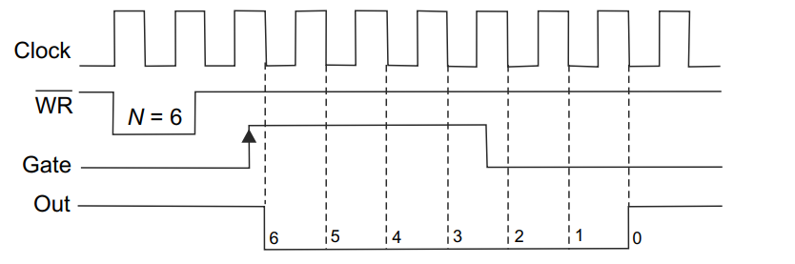
Mode 1: Hardware Retriggerable One-Shot.
Causes the counter to function as a retriggerable, monostable
multivibrator (one-shot).
OUT is initially (after loading CW) high. Also remain high when count value is written into counter.
When gate is triggered, OUT goes low and will remain low until the Counter reaches zero. On completion of count OUT goes high again.
Width of the output pulse depends upon count value.

Slide 17
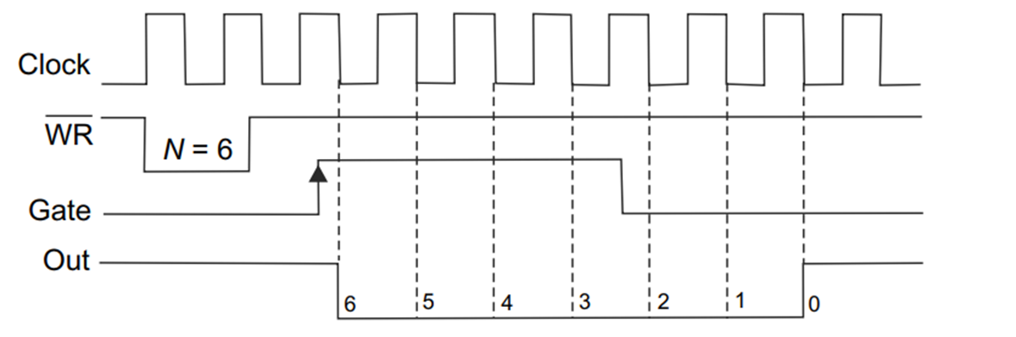
Mode 1: Hardware Retriggerable One-Shot (Continued)
If the GATE input occurs within the duration of counting, the counter is again reloaded with the count and start counting from the beginning.
At the rising edge of WR(CW), OUT becomes high.
At the first falling edge of clock after first rising edge of GATE input, counter
starts counting and output becomes low.

Slide 18
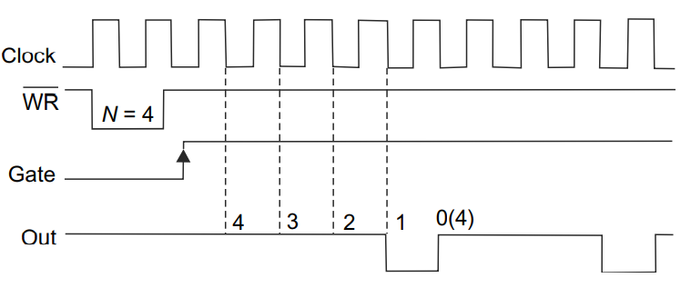
Mode 2: RATE GENERATOR
It is a divide by N counter and used to generate real-time clock interrupt.
If count N is loaded then, output will remain high for (N-1) clock pulses.
After (N-1) clock pulses, out will low for 1 clock pulse and becomes high again.
Count N is reloaded and again out becomes high for (N-1) clock pulse and low for one clock pulse.

Slide 19
Mode 2: RATE GENERATOR (Continued)
This cycle is repeated until the counter is programmed with a new count or until G pin is placed at a logic 0 level.
The G input must be logic 1 for this mode to generate a continuous series of pulses.
At the rising edge of WR(CW), OUT becomes high.
At the first falling edge of clock after first rising edge of WR(LSB), counter
starts counting.

Slide 20
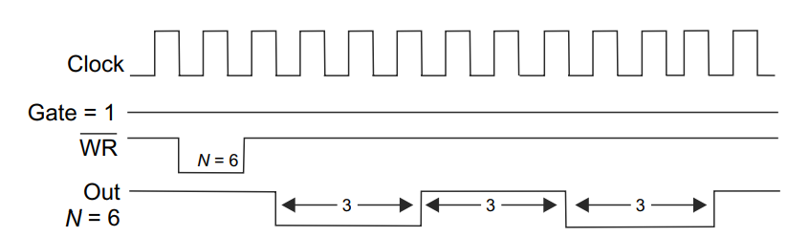
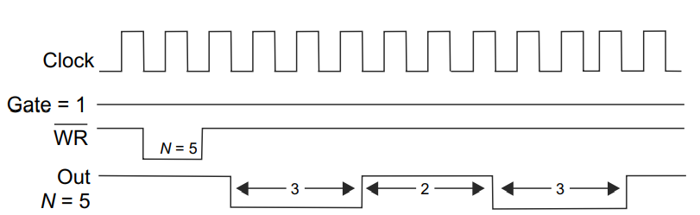
Mode 3: Square Wave Mode.
Used as square wave generator and generates a continuous square wave at the out connection.
Mode 3 is similar to Mode 2 except for the duty cycle of OUT.
If the count (N) is even, the output is high for one half (N/2) of the count and low for next half (N/2) of the count.
If the count (N) is odd, the output is high for (N+1)/2 clock pulses and low for (N-1)/2 clock pulses.
Gate should be maintained at logic 1 always.

Slide 21
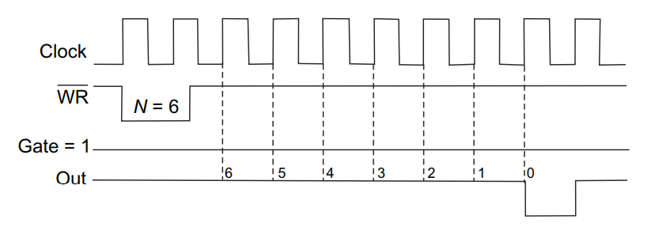
Mode 4: Software Triggered strobe
Allows the counter to produce a single pulse at the output
If count of N is loaded, counting starts, OUT will be high for N clock cycles and low for one clock cycle when count reaches 0.
The low pulse can be used as strobe while interfacing the microprocessor with other peripherals.
The cycle does not begin until the counter is loaded again.
Gate is always high.

Slide 22
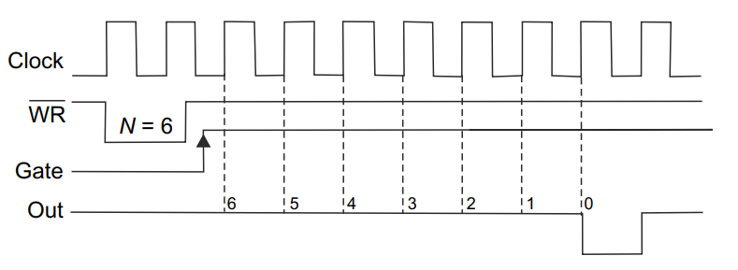
Mode 5: Hardware Triggered strobe
A hardware triggered strobe that function as mode 4, except that it
is started by a trigger pulse on the G pin instead of by software.
When the GATE pulse is triggered from low to high the count begins. At the end of the count, OUT goes low for one clock period.
This mode is also called HARDWARE TRIGGERED STROBE (RETRIGGERABLE)

